Slide 1
Analyzing Bank Uncertainty with Word Embeddings
Steven Stagliano
Tufts MSDS Capstone

Slide 2
The Data
COMPANY | COUNTRY | INDUSTRY | DATE | TRANSCRIPT ID | COMPONENT ORDER | COMPONENT TEXT
AMCORE Financial, Inc. | United States | Banks | 2008-07-17 | 10084 | 3 | Thank you, Bill. As you have just heard, much of our work in the first and second quarter has been to identify and quantify the pockets of our credit…
AMCORE Financial, Inc. | United States | Banks | 2008-07-17 | 10084 | 4 | Thank you Judy and good morning everyone. On our previous quarters earnings calls, I described 10 specific actions we had taken to improve...
transcript_id | ciq_id | snl_id | quarter | year | total_asset_before | total_asset_after | loan_before | loan_after | l2a_delta | loan_diff
1790209 | 13314302 | 4055785 | Q4 2019 | 2019 | $1,2269,288 | $12,159,919 | $10,240,434 | $10,500,284 | 0.028876319 | $259,850
484381 | 2387628 | 4047200 | Q3 2012 | 2012 | $1,6509,440 | $18,242,878 | $11,459,931 | $14,593,134 | 0.105791815 | $3,133,203
1177788 | 349262 | 102420 | Q3 2017 | 2017 | $1,763,750 | $1,776,911 | $1,465,917 | $1,469,842 | -0.003947067 | $3,925
1759737 | 302423 | 100425 | Q3 2017 | 2017 | $5,340,299 | $5,810,129 | $3,414,438 | $3,841,682 | 0.021832187 | $427,244
Notes:
Took 11.5 hours to run the 10 runs. No data processing, just models and building/checking uncertainty lists.

Slide 3
Data Breakdown
Year | Banks | Transcripts
2006 | 3 | 6
2007 | 57 | 71
2008 | 145 | 425
2009 | 120 | 405
2010 | 131 | 461
2011 | 147 | 554
2012 | 149 | 525
2013 | 134 | 505
2014 | 127 | 492
2015 | 123 | 476
2016 | 133 | 493
2017 | 171 | 594
2018 | 180 | 679
2019 | 178 | 686
2020 | 177 | 675
2021 | 174 | 649
2022 | 167 | 639
2023 | 166 | 631
2024 | 157 | 460
Unique Banks | 303
Total Transcripts Used | 9,349

Slide 4
Processing
Tokenization – nltk.tokenize.word_tokenize
Clean Punctuation – Regex
Part-of-Speech Tagging – nltk.pos_tag
Create Bigrams – gensim.models.phrases.phrases
Lemmatization – nltk.stem.WordNetLemmatizer
Stop Word Removal – nltk.stopwords (removed below and haven from default list)
Notes:
Pos_tag takes longer but is more accurate for English text
Left hyphens for words like post-election
Bigrams used to be last phase Started lemmatizing later in cycle Looked into CNNs for uncertainty tagging but proved to difficult
Lemmatized due to work done by S&P data science team
Other choices: keep or exclude hyphens, rework for efficiency gains

Slide 5
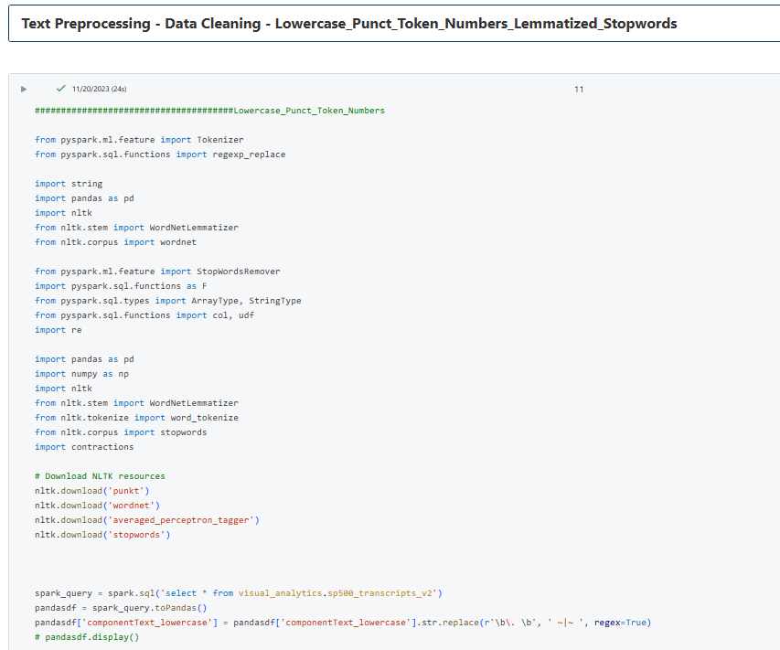

Slide 6

Bigram Hyperparameters
Min_count: 10
Scoring: default
Threshold: 100
Sample Bigrams Created
covid-19_pandemic
prove_incorrect
imply_forward-looking
vary_quarter-to-quarter
omicron_variant
Datapoints
Bigram frequency in full corpus uncertainty word dictionary: ~20%
Bigram frequency in yearly corpus uncertainty words dictionary: ~18%
Notes:
Alternative scoring is npmi which has a threshold range of -1 to 1. npmi stands for normalized pointwise mutual information
Bigrams after stop words for efficiency
After lemmatization because results still seemed solid

Slide 7
Word2Vec - Hyperparameters
model = gensim.models.Word2Vec (
vector_size #Number of features in word vector
window #Context window size (in each direction)
min_count # Words must appear this many times to get included in final result
sg = 1, # 0: CBOW, 1: Skip-gram
hs = 0, # 0: Negative Sampling, 1: Hierarchical Softmax
negative = 5 #Number of negative samples)
model.train(
corpus = lemmmatized_bigram_corpus
total_examples=len(lemmmatized_bigram_corpus)
epochs #How many training passes to take)

Slide 8
Hyperparameter Testing
Hyperparameters |  |  |  | Custom Metrics |  |  |  | Correlation Coefficient
Vector Size | Window | Min Count | Epochs | Total Unique Words | Avg. Rare Words | Common Words - Soto | Unique Words Full Corpus | Reg - YC | Reg - FC | TF-IDF - YC | TF-IDF - FC
200 | 10 | 10 | 10 | 908 | 6.81 | 22 | 6 | -0.1001 | -0.0552 | 0.0251 | -0.0293
300 | 10 | 10 | 10 | 963 | 7.50 | 13 | 4 | 0.0617 | -0.0867 | 0.0275 | -0.0470
400 | 10 | 10 | 10 | 963 | 7.75 | 11 | 5 | 0.0515 | -0.0643 | 0.0195 | -0.0459
500 | 10 | 10 | 10 | 956 | 8.56 | 11 | 6 | 0.0249 | -0.0305 | 0.0134 | -0.0253
300 | 5 | 10 | 10 | 940 | 7.69 | 13 | 22 | 0.0149 | -0.0192 | 0.0126 | -0.0110
300 | 10 | 10 | 10 | 963 | 7.50 | 13 | 4 | 0.0617 | -0.0867 | 0.0275 | -0.0470
300 | 15 | 10 | 10 | 957 | 7.13 | 14 | 6 | 0.0318 | -0.0723 | 0.0320 | -0.0517
300 | 20 | 10 | 10 | 937 | 7.94 | 15 | 12 | -0.0585 | -0.0854 | 0.0329 | -0.0533
300 | 10 | 5 | 10 | 1178 | 8.06 | 10 | 77 | -0.0004 | -0.0653 | 0.0039 | -0.0181
300 | 10 | 10 | 10 | 963 | 7.50 | 13 | 4 | 0.0617 | -0.0867 | 0.0275 | -0.0470
300 | 10 | 15 | 10 | 767 | 6.75 | 15 | 10 | 0.0091 | -0.0629 | 0.0084 | -0.0384
300 | 10 | 20 | 10 | 657 | 7.50 | 23 | 29 | -0.0212 | -0.0655 | -0.0020 | -0.0336
300 | 10 | 10 | 5 | 1019 | 5.19 | 3 | 20 | 0.0219 | -0.0257 | 0.0145 | -0.0253
300 | 10 | 10 | 10 | 963 | 7.50 | 13 | 4 | 0.0617 | -0.0867 | 0.0275 | -0.0470
300 | 10 | 10 | 15 | 867 | 9.00 | 20 | 3 | 0.0485 | -0.0610 | 0.0282 | -0.0318
300 | 10 | 10 | 20 | 801 | 8.69 | 21 | 23 | -0.0925 | -0.0769 | 0.0144 | -0.0335
 |  |  | Averages: | 916.4 | 7.58 | 14.7 | 17.15 | -0.0006 | -0.0593 | 0.0177 | -0.0342
Notes:
Total Unique Words = Set of every word from each year
Avg Rare Words = A word is rare if it appears 3x more in a given year than it’s average across all years
Common Words Soto = How many words in common with the soto dictionary
Unique Words Full Corpus = In given year, how many words were unique from other runs

Slide 9
Hyperparameter Testing

Slide 10
Hyperparameters on Correlation Coefficient

Slide 11
Uncertainty List Creation Decisions
Default Algorithm in Word2Vec: Cosine Similarity
Number of words chosen:
Each Yearly Corpus: Top 100
Full Corpus: Top 150
Seed words:
[uncertainty, uncertain, ambiguity, confusion, unpredictable, unpredictability]
Minimum number of banks with word: 2

Slide 12
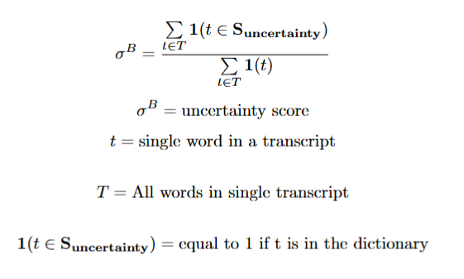
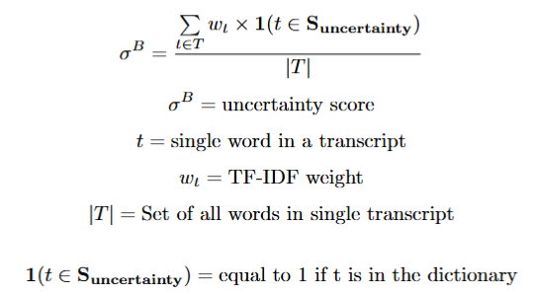
Uncertainty Score Calculation
Soto TF-IDF Calculation
“Regular” Calculation

Slide 13
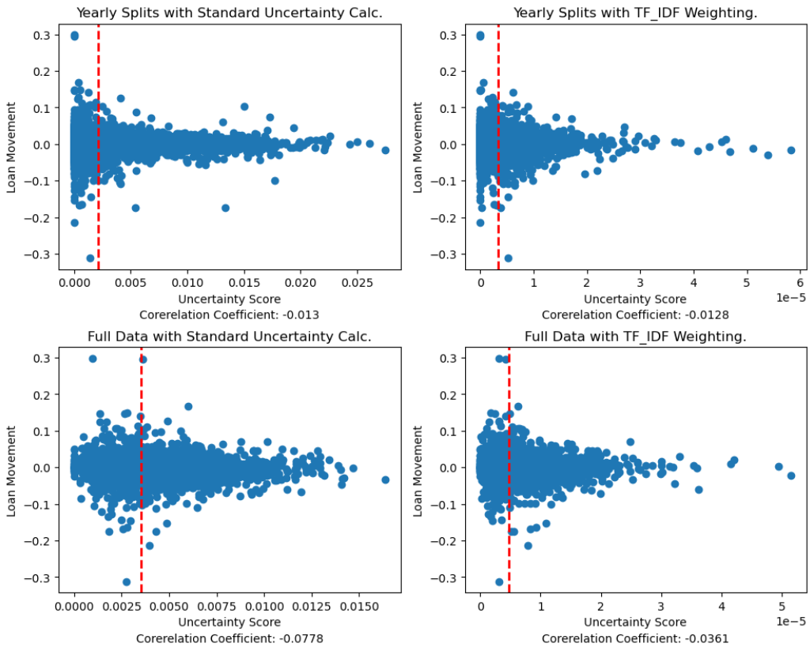
Results – Best model over single run
Notes:
Soto looks at log of the loan amount
Mean score was .23 to .7 in soto
See in R Squared values closer to the .5 - .9 range depending on test

Slide 14
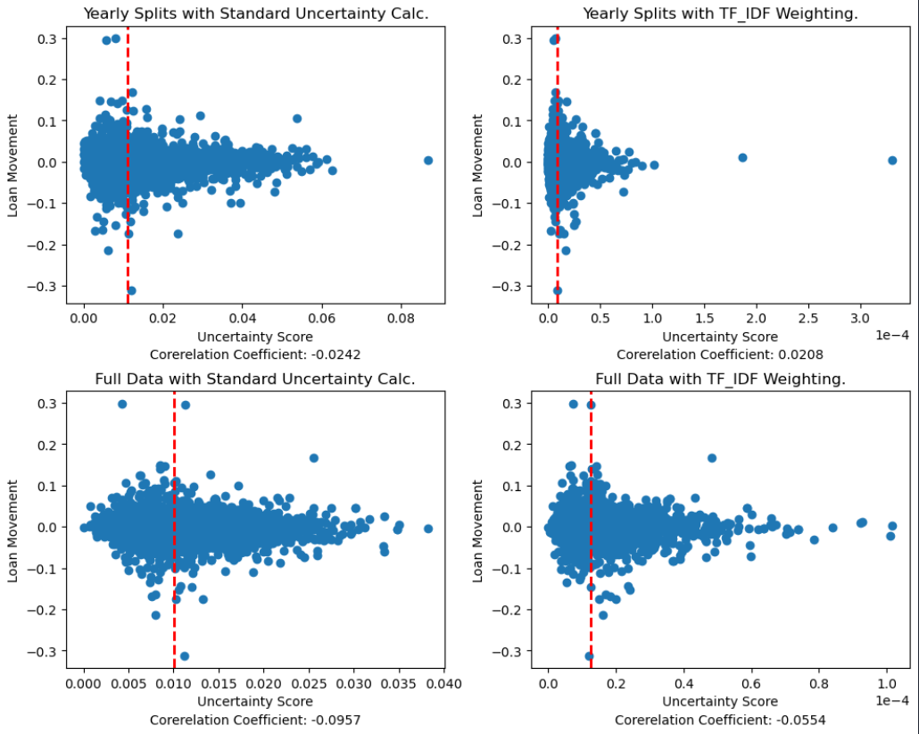
Results – Words with >4 appearances over 10 Runs

Slide 15
10 Run - Averages
Metric | Mean | Std. Dev.
YC - Reg | -0.0467 | 0.0273
FC - Reg | -0.0828 | 0.0076
YC - TF-IDF | 0.0207 | 0.0039
FC - TF-IDF | -0.0534 | 0.0086
# of Appearances in 10 Runs | Word Count
10 | 76
9 | 17
8 | 15
7 | 10
6 | 11
5 | 14
4 | 12
3 | 20
2 | 39
1 | 75
10 Appearances | 1 Appearance
geopolitical_tensions | basel_ii
trade_wars | dodd-frank
debt_ceiling | inflationary_pressures
 | trump_administration

Slide 16
2009 | 2010 | 2011 | 2012 | 2013 | 2014 | 2015 | 2016 | 2017 | 2018 | 2019 | 2020 | 2021 | 2022 | 2023 | 2024
illiquidity | gulf_oil | sections_entitled | fiscal_cliff | sequester | disclosure_contained | provisions_contained | referendum | forms_10-q | option_exercise | trade_wars | uncertainty_surrounding | downside_scenarios | geopolitical_tensions | social_media | actual_results
documents_filed | re-engineering | expressly_disclaim | exchange_act | debt_ceiling | complete_discussion | appropriately_reserved | reforecast | pro-growth | nafta | trade_war | silver_lining | formal_agreement | covid-19_pandemic | burn-down | presidential_election
strained | involve_certain | section_21e | eurozone | provisions_contained | reoccur | financial_condition | congressional | status_quo | applies_equally | late-cycle | find_ourselves | adaptable | ukraine | over-earning | backloaded
involve_certain | assertive | double-dip | documents_filed | exchange_act | terminology | persistently | harm | permian | gross-up | tariff | challenges_presented | financial_condition | consumer-friendly | vary_materially | pull-forward
intervention | background_noise | debt_ceiling | section_21e | government_shutdown | flow-through | complete_discussion | expressly_qualified | flooding | changing_gears | applies_equally | epicenter | efficacy | supply_chains | sticker | navigated
turbulence | spill | disclosure_contained | de-lever | hereof | expressly_qualified | expressly_qualified | date_hereof | restoration | tight_labor | tight_labor | presidential_election | nydig | labor_shortages | aftermath | hereof
fortified | unintended | pre-payments | generalization | 21e | fas_91 | unduly | presidential | rhetoric | trade_war | legend | pandemic | moat | tight_labor | mid-70s | geopolitical
weathering | fragile | non-investment | statute | complete_discussion | low-interest | terminology | complete_discussion | incorrect | securities_litigation | securities_litigation | fog | vary_materially | rapidly_changing | cdars | quantitative_tightening
turbulent | restrained | temptation | 27a | qe3 | date_hereof | forms_10-k | mismatch | augmenting | saul | messy | endure | virus | critically_important | navigating | navigating
immune | sluggish | memorandum | putbacks | terminology | entitled | boosting | 10-qs | date_hereof | hopes_beliefs | reform_act | murky | subsides | variant | unfolded | crossfirst
securities_litigation | delever | de-leveraging | put-back | expressly_qualified | forms_10-k | asset-sensitive | forms_10-k | expressly_qualified | ricky | tension | fearful | work-from-home | geopolitical | insulated | discovery
instability | hereof | iberiabank_corporation | monolines | historical_facts | advise | furnished | volatility | subsidy | vesting | brexit | unprecedented | society | closely_monitoring | prove_incorrect | offense
reform_act | offshore | economic_condition | fatigue | escalating | mismatch | 10-qs | volatile | crude | rbb_bancorp | prove_incorrect | conserve | setback | financial_condition | hopes_beliefs | amid
factual | historical_facts | unsettled | hesitation | entitled | furnished | adr | item_1a | snow_removal | escalating | rbb_bancorp | withdrawing | prove_incorrect | war | macro | election
unsettled | forms_10-k | justified | suit | deficit | involve | incorrect | back-to-back | transpired | preceded | hopes_beliefs | unknown | stripping | vary_materially | uncertain | hancock_whitney
posed | guarded | uneven | uneven | prospectus | herein | undue | choppy | 10-qs | misspoke | publicly_revise | navigate | unrest | conflict | apology | navigate
Notes:
Section 21e – part of forward-looking statements read at start of transcript

Slide 17
Uncertainty Word List – Full Corpus
given | 38598 | unusual | 3320 | surrounding | 586 | tension | 103 | zoning | 26 | stalemate | 13
environment | 37906 | covid-19 | 2731 | lumpiness | 576 | stressful | 103 | trepidation | 25 | obamacare | 13
risk | 36371 | noise | 2406 | prolonged | 519 | fragile | 94 | ambiguity | 25 | clearer_picture | 13
factor | 21770 | macro | 2350 | ebb | 470 | ever-changing | 94 | post-election | 25 | beholden | 13
economic | 20612 | clarity | 2150 | climate | 456 | obstacle | 82 | gyration | 24 | paralysis | 13
forward-looking_statements | 17607 | inflation | 2135 | place_undue | 445 | latitude | 70 | adaptable | 22 | option_exercise | 13
economy | 17093 | volatile | 2081 | fluid | 351 | unsettled | 66 | pandemic-driven | 21 | dysfunction | 12
however | 14428 | caution | 1914 | historical_facts | 340 | prove_incorrect | 65 | posturing | 20 | trade_wars | 12
uncertainty | 11822 | uncertain | 1847 | complete_discussion | 327 | unrest | 65 | decoupling | 20 | microeconomic | 12
condition | 8726 | lack | 1781 | inherently | 320 | vary_materially | 64 | notoriously | 18 | biden_administration | 12
challenge | 7874 | lumpy | 1632 | choppy | 315 | onerous | 59 | slow-growing | 18 | deterrent | 12
difficult | 7372 | macroeconomic | 1585 | geopolitical | 312 | instability | 58 | beast | 18 | geopolitical_tensions | 11
pandemic | 7338 | backdrop | 1343 | uneven | 274 | sporadic | 48 | pundit | 17 | greater-than-anticipated | 11
subject | 6704 | mindful | 1250 | unknown_risks | 261 | uncertainty_surrounding | 47 | desist | 17 | underestimating | 11
differ_materially | 5832 | delay | 1188 | unpredictable | 260 | resubmit | 41 | therewith | 16 | mpr | 11
volatility | 5680 | vary | 1113 | unclear | 217 | unevenness | 38 | unchartered | 15 | contentious | 11
headwind | 5602 | navigate | 943 | financial_condition | 211 | debt_ceiling | 38 | unanswered | 15 | necessitates | 11
challenging | 5411 | involve | 901 | unforeseen | 192 | angst | 37 | choppier | 15 | resubmitted | 11
concern | 4543 | unknown | 815 | actual_results | 169 | murky | 36 | apprehension | 15 | swirling | 10
predict | 4390 | difficulty | 778 | fiscal_cliff | 165 | unpredictability | 35 | opaque | 15 | intrusion | 10
prudent | 3851 | unexpected | 756 | government_shutdown | 165 | irregular | 33 | postponement | 14 | fate | 10
quarter-to-quarter | 3510 | involve_risks | 695 | precision | 141 | austerity | 31 | gridlock | 14 | chaotic | 10
cause | 3505 | unprecedented | 690 | bumpy | 135 | fluidity | 28 | preparatory | 14 | uncertainly | 10
cautious | 3469 | certainty | 658 | turbulent | 131 | consternation | 28 | ignorance | 13 | watchword | 10
cause_actual | 3334 | risks_uncertainties | 655 | frustration | 108 | circumspect | 27 | tenuous | 13 | lulled | 10

Slide 18
Transcript: Preferred Bank Q2 2019 (1833962) (4th largest uncertainty for yearly corpus word lists, TF-IDF weighting).
Uncertainty words: difficult_predict, tension, trade_war, impossible, prove_incorrect, closely_monitoring, uncertainty, environment, retrospect
“So there is also a number of customers existing with a buying property with their own cash and our credit line, okay. And also, there are people as -- very relative small amount of people in view of the tension in the trade tariff trade war has started building up the inventory a little bit before the tariff become -- really becomes effective now.
So its all these factors thats happening at quarter end. Some of these drawdown has been repaid back. And as usual, it is almost impossible for us to predict the C&I projection in the third and fourth quarter. C&I is a continuous and relentless effort that you just work on it, work on it. Sometime it all happens such as this quarter. Sometime very little happens in 1 quarter.”
Next Quarter: -2.16% Loan-to-Assets Ratio

Slide 19
Transcript: Home Bancshares, Inc. Q4 2013
“Yes. We'd expect, as you said, a little more pressure bringing on their portfolio for the full quarter versus the other. Also have some of the FAS 91 marks coming in, so that's a little bit unpredictable. But I think we were 650 for this quarter. I would expect that to trend down a little bit, little more pressure on there. Liability side, you can see that they were pretty consistent with where we are. So it's really on the loan side.”
“Financial Accounting Standard Number 91 deals with the calculation of investment income and amortized cost for mortgage backed securities, as well as whole mortgages and callable bonds.” - Actuarial Research Clearing House
Next Quarter: -0.87% Loan-to-Assets Ratio
Notes:
Financial Accounting Standard Number 91 deals with the calculation of investment income and amortized cost for mortgage backed securities, as well as whole mortgages and callable bonds.

Slide 20
Transcript: Sterling Bancorp Q3 2023 (2925824) (Largest uncertainty for full corpus word lists, TF-IDF weighting).
“I think my own sense is that they’ll be a little cautious and patient, but that the bias is still towards another 1 or 2 increases until there is a sense that inflation is more under control, and it remains stubbornly high. And high inflation is a very difficult road to navigate in the -- in most all industries, but certainly in financial services.”
“It’s a very uncertain time just in terms of what’s available for us to do. We’re trying to preserve our capital. We’re trying to maintain the strengths that we have.”
Next Quarter: -2.08% Loan-to-Assets Ratio

Slide 21
Home Bancshares, Inc. Q3 2010
“We decided, based on our capital, when we look at that transaction, we wanted it because it tacked on our existing franchise. It took us into Tallahassee. But we decided that it needed to be a good transaction for us or we werent going to play, because I think the FDIC was leading us all with our heads sticking out to chop them off, because we went from 80-20 and 95-5 to 80-20 or whatever you want to pick them on a two-tiered deal, and then suddenly, we went into three tranches with a donut hole in the middle, and it just got so confusing. And we as buyers kept chasing that money. We backed off, and it certainly appears that a lot of people have backed off and decided, they have to be really good transactions or they are not going to play. ”
Regarding 95-5:
“Until March 26, 2010, the FDIC shared losses with assuming banks on an 80/20 basis until the losses exceeded an established threshold defined in the agreement, after which the basis for sharing losses shifted to a 95/5 basis. Sharing losses on a 95/5 basis was eliminated for all SLAs executed after March 26, 2010.” [FDIC, The Long-Run Effects of Losing Failed Bank Auctions]

Slide 22
Processing Stats
Starting Tokens | 66,087,551
Tokens After Bigrams | 57,728,275
Total Tokens after Processing | 28,929,243
Unique Tokens | 77,415
Total Bigrams | 682,234
Unique Bigrams | 2,289

Slide 23
Appendic - Soto Uncertainty Word List (highlights appear in full corpus uncertainty word list as well)
unprecedented | confluence | emerged | face | cycles | hampering
dysfunction | referendum | congress | encountered | lingering | crises
climate | political | war | elections | stimulative | myriad
uneven | midst | ripple | tsunami | faced | rican
prolonged | election | midterm | looming | fiscal | crash
challenging | anxiety | immune | persisted | psychology | makers
stressful | attacks | confronting | headwinds | tariff | persists
macroeconomic | persistently | tensions | turbulence | threats | heightened
geopolitical | terrorist | consumption | tumultuous | amid | environments
uncertainty | concerns | prevailed | rhetoric | amidst | facing
uncertain | persistent | threat | posed | presidential | turmoil
fragile | adapted | stimulus | governmental | faces | challenges
austerity | intervention | eurozone | sluggish | euro | fears
gridlock | eu | illiquidity | weathering | conditions | downturn
paralysis | deficit | gyrations | society | spite | unfolded
turbulent | lackluster | deficits | currents | legislative | geo
navigate | bipartisan | ltro | reforms | clouded | prevailing
backdrop | peso | navigating | persist | legislature | struggles
economic | nafta | benign | iraq | weathered | navigated
unrest | commonwealth | sparked | recessionary | sars | flash
surrounding | impasse | brexit | franc | monetary | amplified
unsettled | swiss | tariffs | sequester | deflationary | unstable
environment | deflation | withstand | upheaval | ceiling | realities
instability | reactions | protracted | shutdown | governments | cliff
 |  |  |  |  | terrorism

Slide 24
Appendix – Issues with single-bank words

Slide 25
Appendix: Berkshire Hills Bancorp Q1 2016 (Bad Result)
“Thank you, Josephine, nice job as always. So as Jo said, were looking for second quarter core EPS thats in line with what we reported this quarter. And of course, we will work hard and look to do better if we can. Despite concerns over a slowing U.S. economy, the local region does feel like its continuing to make progress, and we remain cautiously optimistic.”
Next Quarter: +1.31% Loan-to-Assets Ratio

Slide 26
Appendix – imply_forward-looking (Bad Result)
Irregularities when lemmatizing before bigram creation
“In todays Q&A session, we may make forward-looking statements about our expectations, estimates and outlook for the future. Please refer to our earnings release, management comments and other public filings for more information on the various factors in the business that may cause actual results or outcomes to vary from those projected in or implied by such forward-looking statements.”
Notes:
imp

Slide 27
Appendix - Time Taken
Processing with lemmatization: ~60 seconds/yr
Yearly model creation: ~45 seconds/yr
Full corpus model creation: ~20 minutes
Yearly uncertainty list creation ~35 seconds/yr
Full corpus uncertainty list creation: ~71 seconds
Full corpus IDF creation: ~6 minutes
Creating IDF dictionaries: ~60 seconds/year
Calculating uncertainty scores ~7 minutes
Total: 84 min (~70 min after processing)
Notes:
Early processing runs took 12 hours

Slide 28
Appendix - Uncertainty/Count (Full Corpus Min 5)
Notes:
GSIB: global systemically important bank (if it fails the economy could collapse)
DFAT: Australian banking authority
FRTB: Part of capital requirements set via Basel

Slide 29
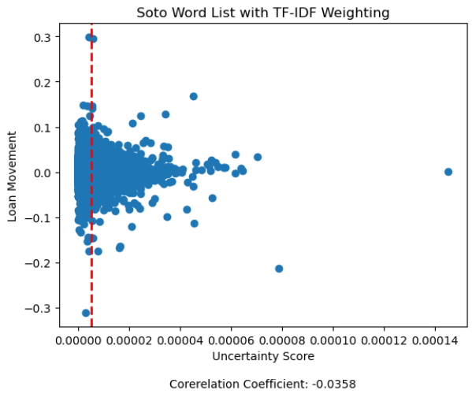
Appendix – Soto Uncertainty Calc

